Slide 1
Standard slides for Business Central analytics sessions
Copy-paste-edit at your own will

Slide 2









Typical analytics needs in organizations
Typical ways to consume data
KPIs
Dashboards
Financial reports
Data aggregation
Performance data
Leadership
Trends, summaries
Organizarional hierachy
Management
Managerial reports
Ad-hoc analysis
Detailed
data
Staff
Operational reports
On-screen task data
Notes:
This slice shows where Power BI, Data Analysis, and Excel fit into the analytics story

Slide 3
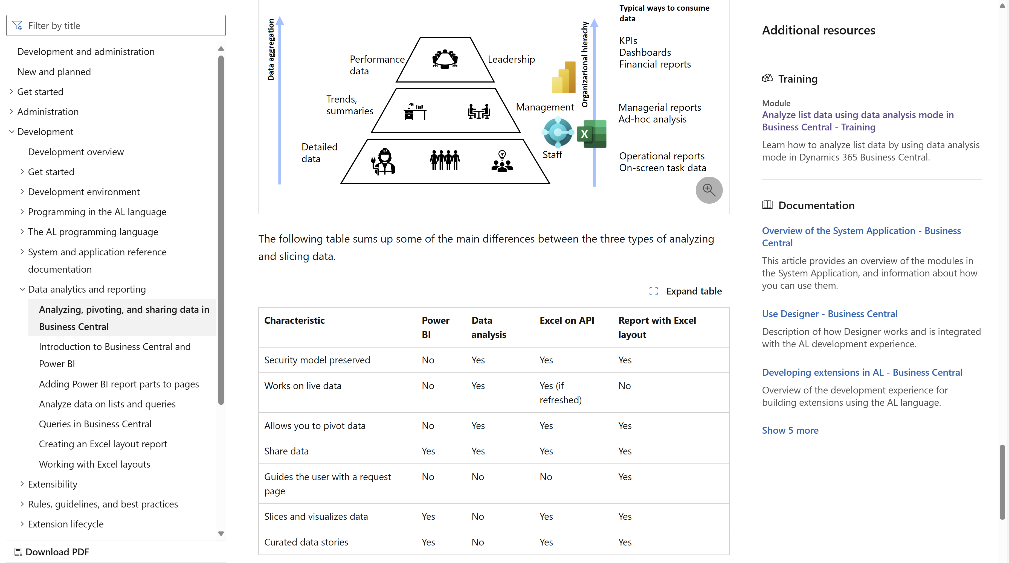
Developer docs https://aka.ms/bcDeveloper
Notes:
This is the developer docs that explains the BI triangle., how tools map to user needs, and different characteristics of the tools.

Slide 4


Analytics content and choice of technology
Security model preserved
Live data
Pivot data
Share the data
Security model preserved
Live data
Guide the user with a request page
Share the data
Pivot data
Slicers + visuals
New security model
Refresh needed (for now)
Curated data stories
Slices, KPIs, visuals
Not for pivoting data
Share the data
Notes:
This overview shows some properties of each cabability

Slide 5
The world is changing (in reporting)
If customer asks, “Can you build me a report?”
STOP asking “Sure. How should it be formatted?”
INSTEAD ask “What do you need to analyze and for what?”
THEN choose the tool of choice
Power BI (and embed), or
Query/List page with Data Analysis, or
AL report with Excel layout
Notes:
You might end a session for developers with this (recapping the BI triangle)

Slide 6
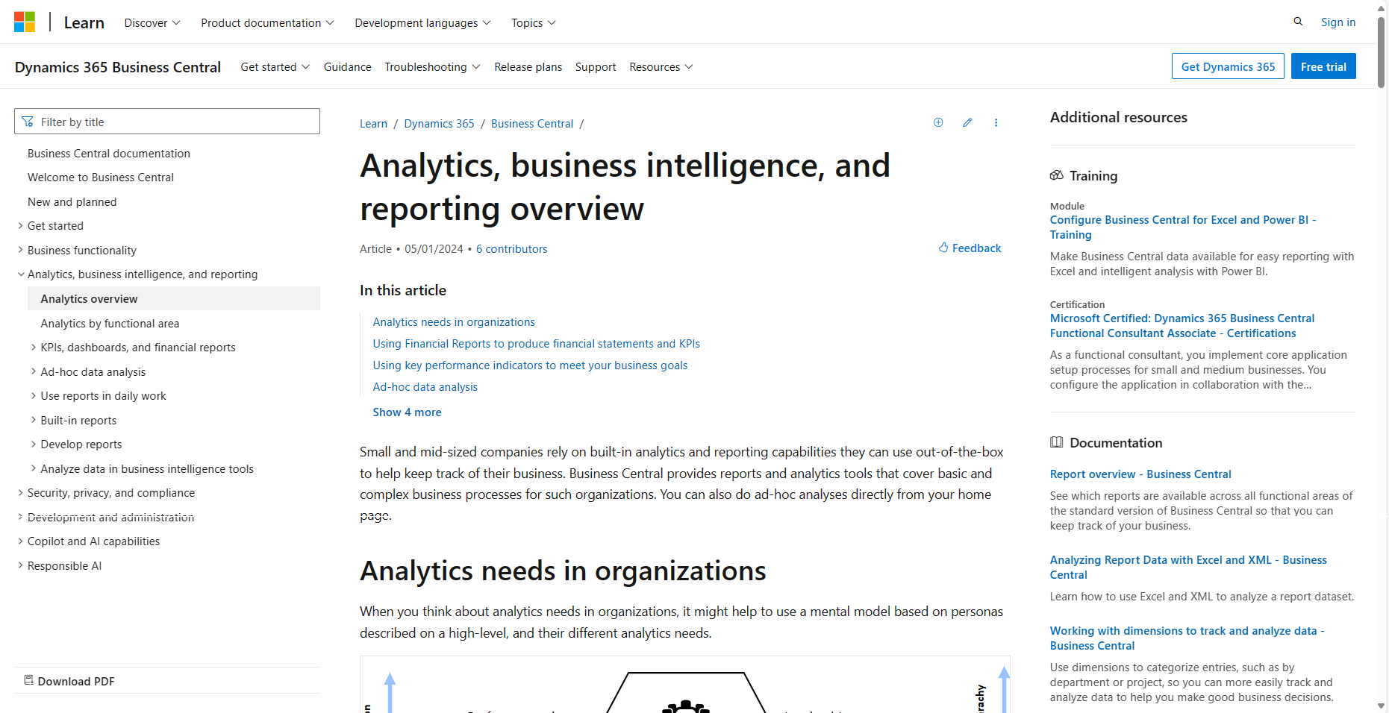
aka.ms/bcAnalytics (for users)
Notes:
This is the general analytics story end-to-end

Slide 7
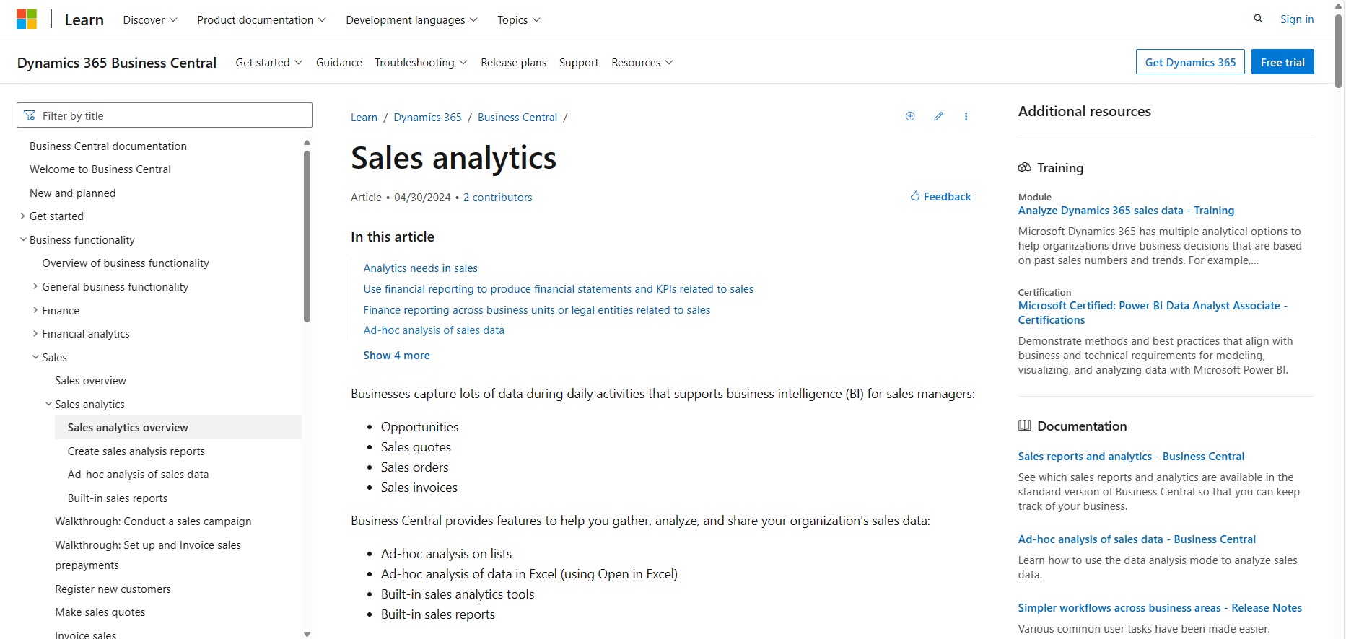
Analytics per functional area (finance, sales, purchase, inventory, …)
Notes:
This is the analytics story end-to-end for each functional area

Slide 8
Analytics aka links per functional area
aka.ms/bcFinanceAnalytics
aka.ms/bcSalesAnalytics
aka.ms/bcPurchasingAnalytics
aka.ms/bcFixedAssetsAnalytics
aka.ms/bcProjectAnalytics
aka.ms/bcInventoryAnalytics
aka.ms/bcManufacturingAnalytics

Slide 9
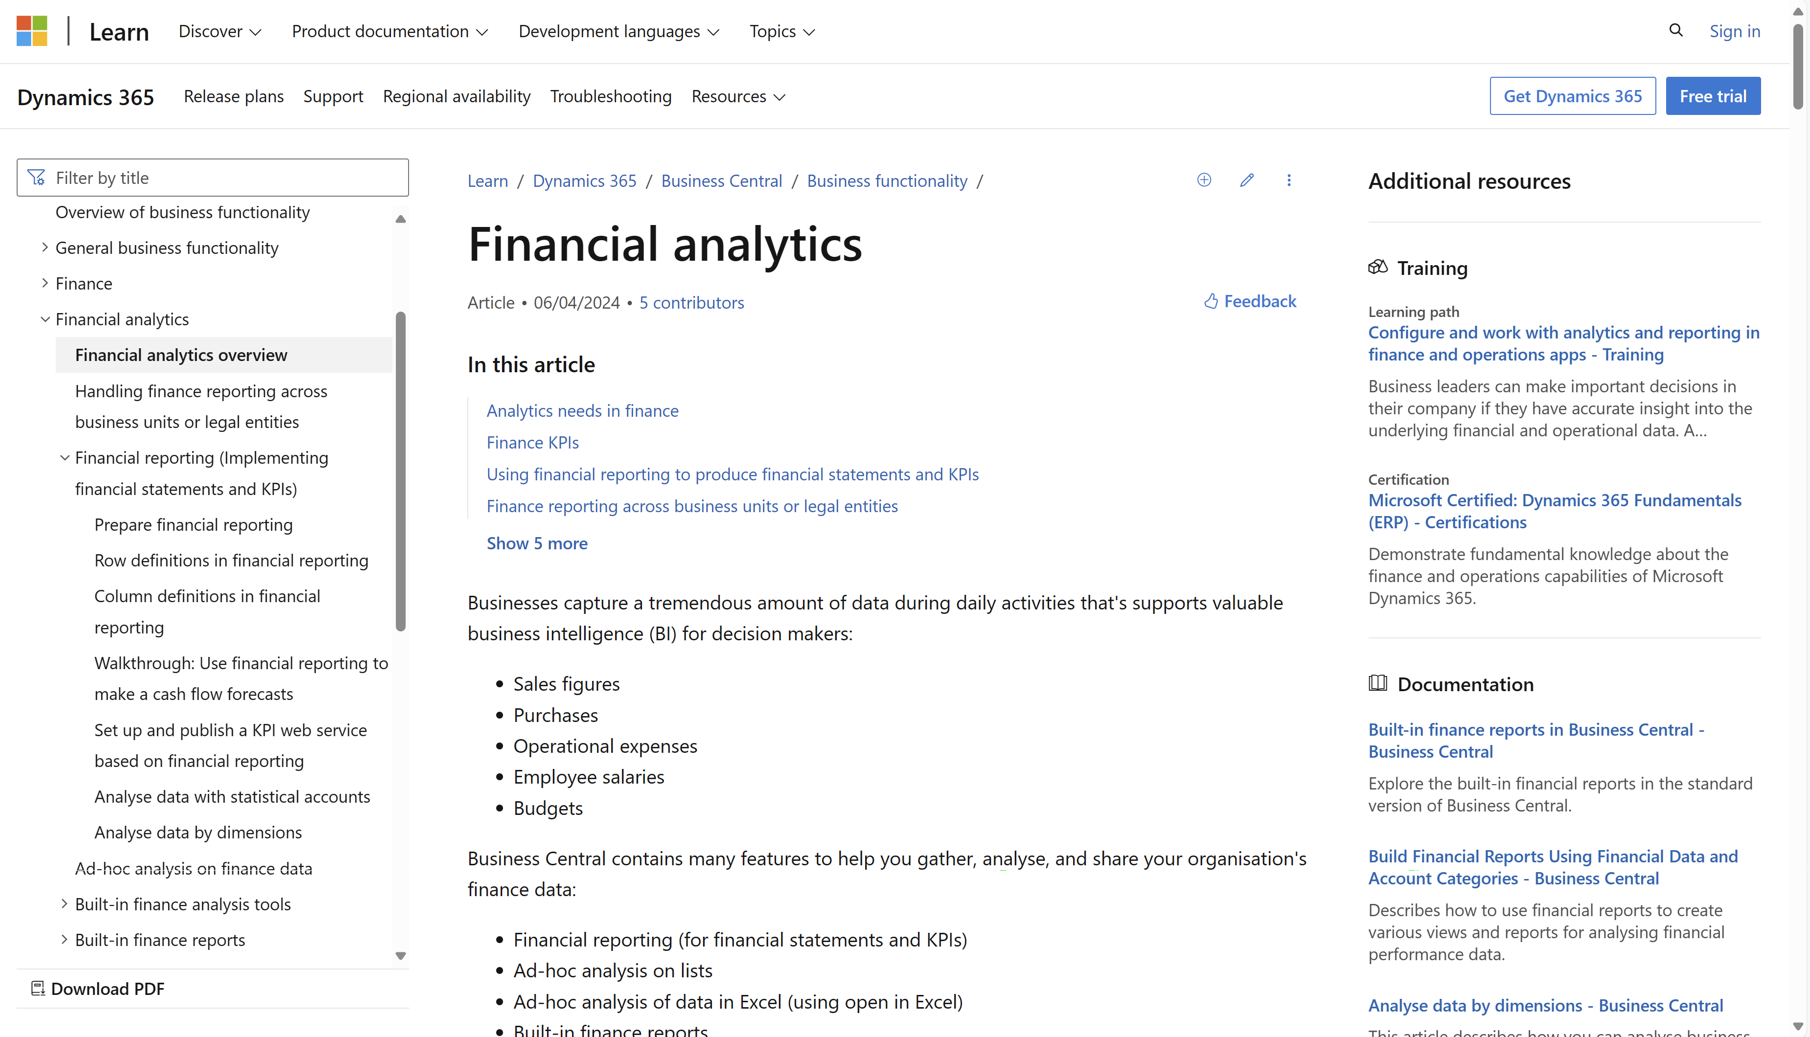
Example: Financial Analytics
Notes:
This is the analytics story end-to-end for each functional area

Slide 10
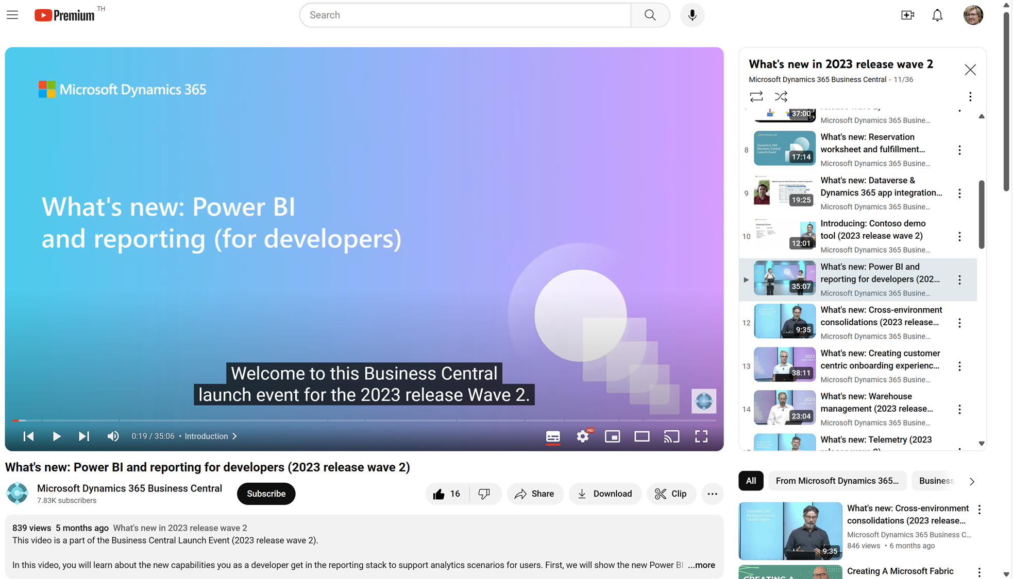
Watch the video to learn more…
Notes:
This video explains the BI triangle for developers

Slide 11
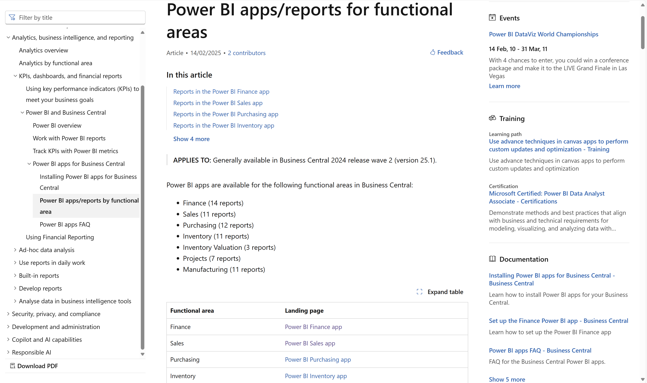
Notes:
Introduced in 25.1
Go to aka.ms/beAnalytics and then navigate down to table of content

Slide 12
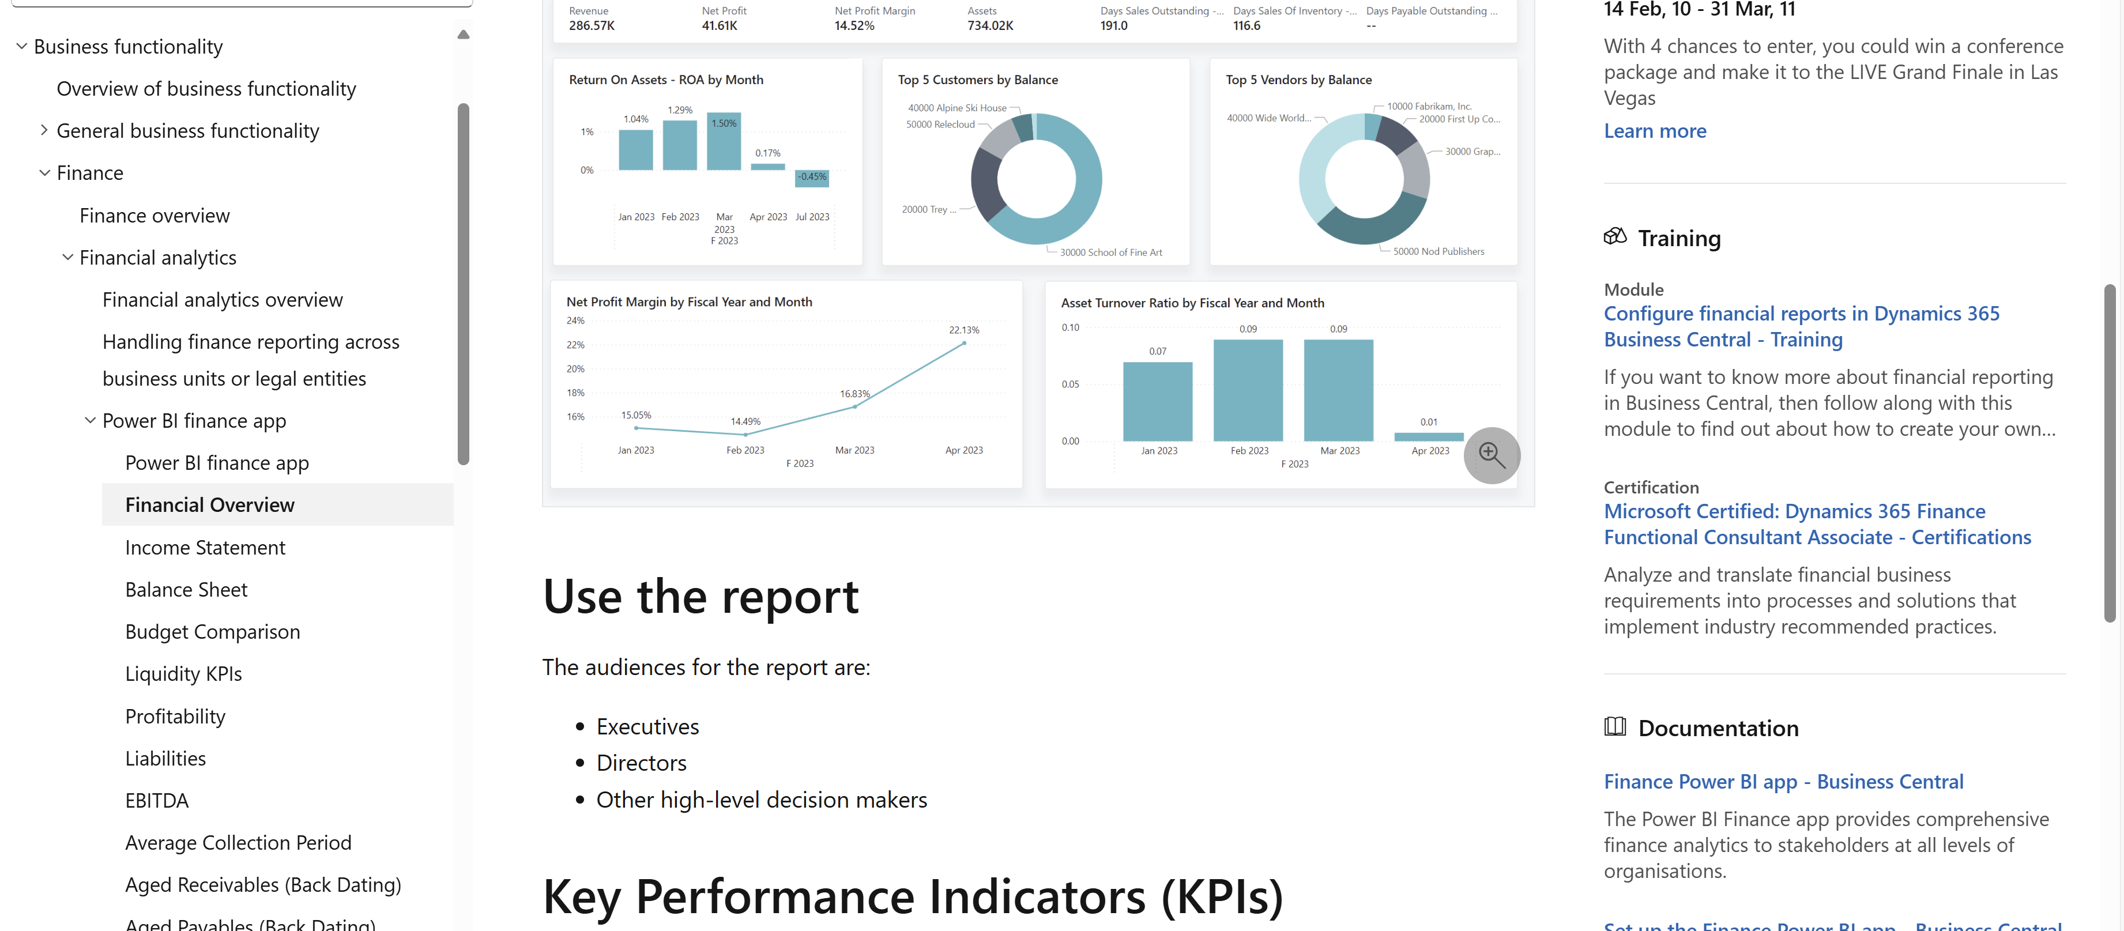
Each app is documented under its functional domain
Notes:
Each app is documented under its functional domain (use the aka links to navigate there)
Each report is documented with screenshots, usage scenarios, …
Each KPI is documented

Slide 13
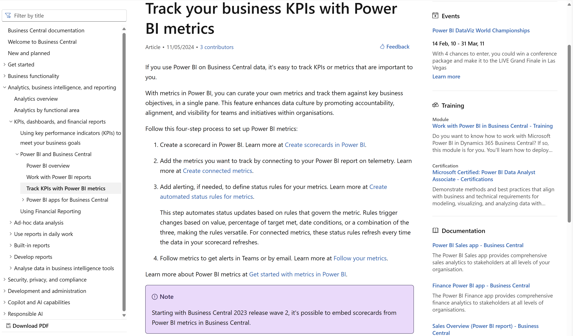
Notes:
Power BI metrics is included in Power BI pro license.

Slide 14
Power BI embed (for developers)
Notes:
Power BI embed (for developers)

Slide 15
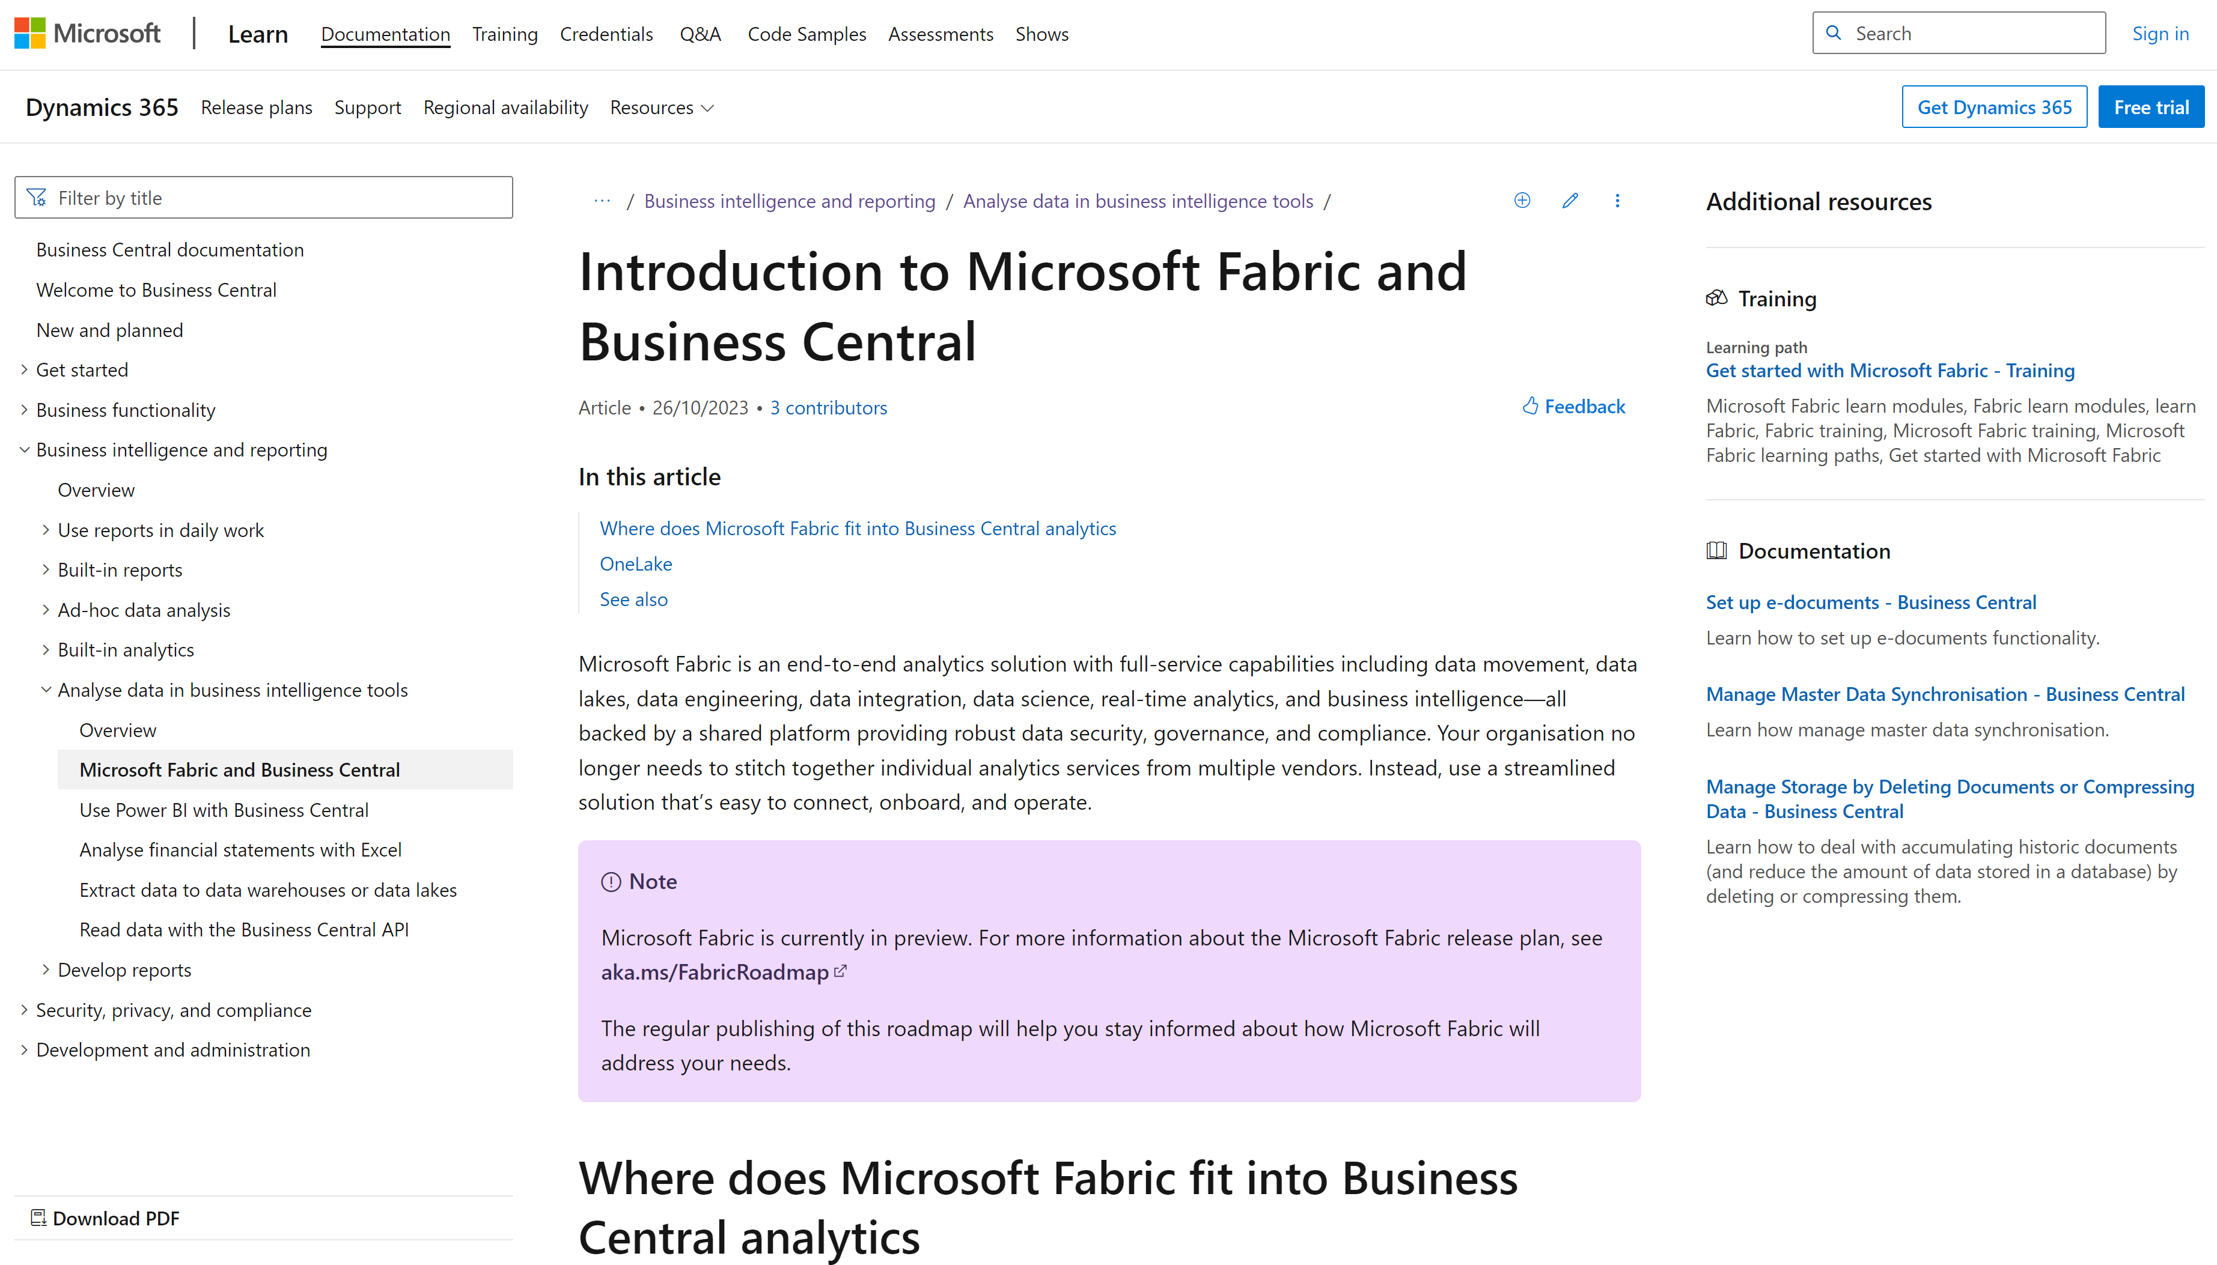
Notes:
If anyone asks about BC and Fabric

Slide 16
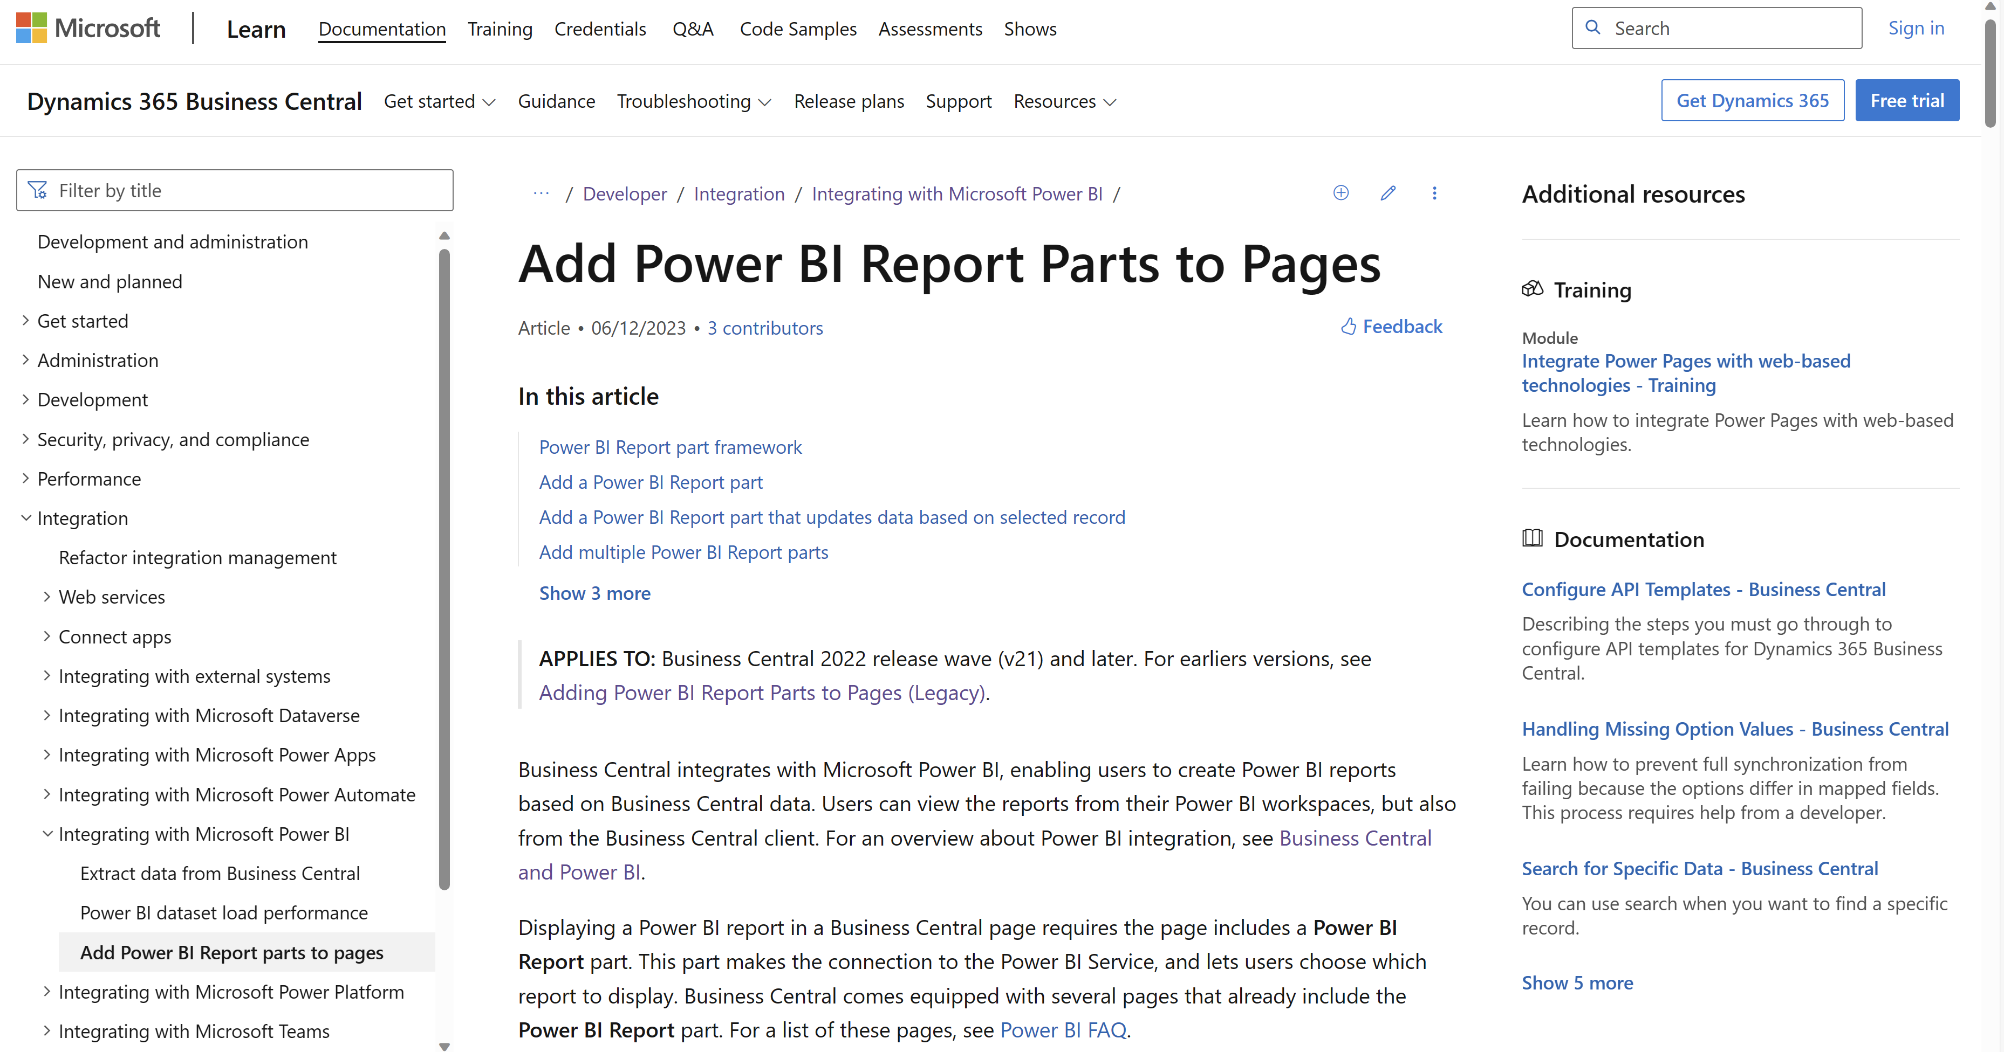
Notes:
Developer docs on how to embed Power BI on AL pages

Slide 17
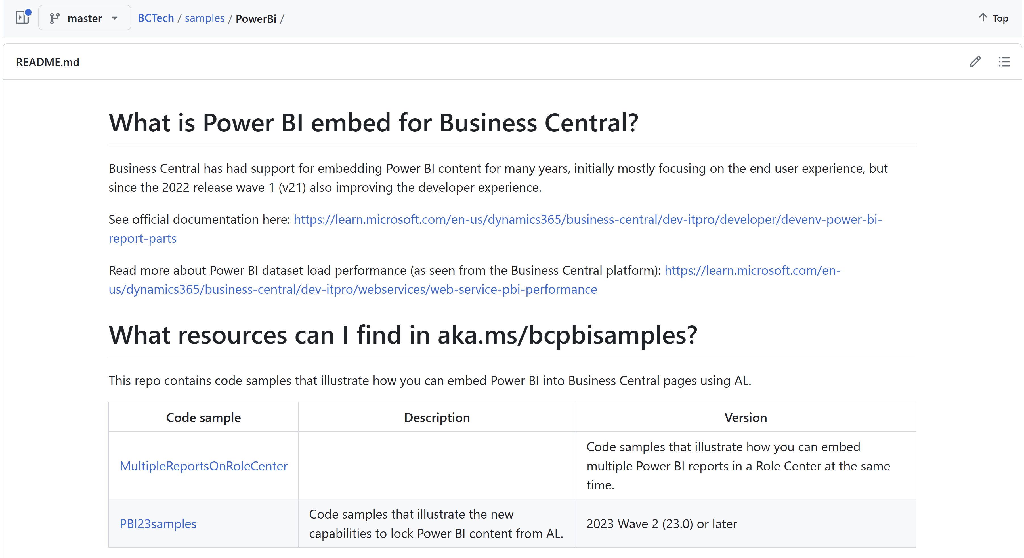
aka.ms/bcpbisamples
AL code samples for the new PBI embed capabilities in 2023w2
Notes:
Sample code on how to embed Power BI on AL pages

Slide 18
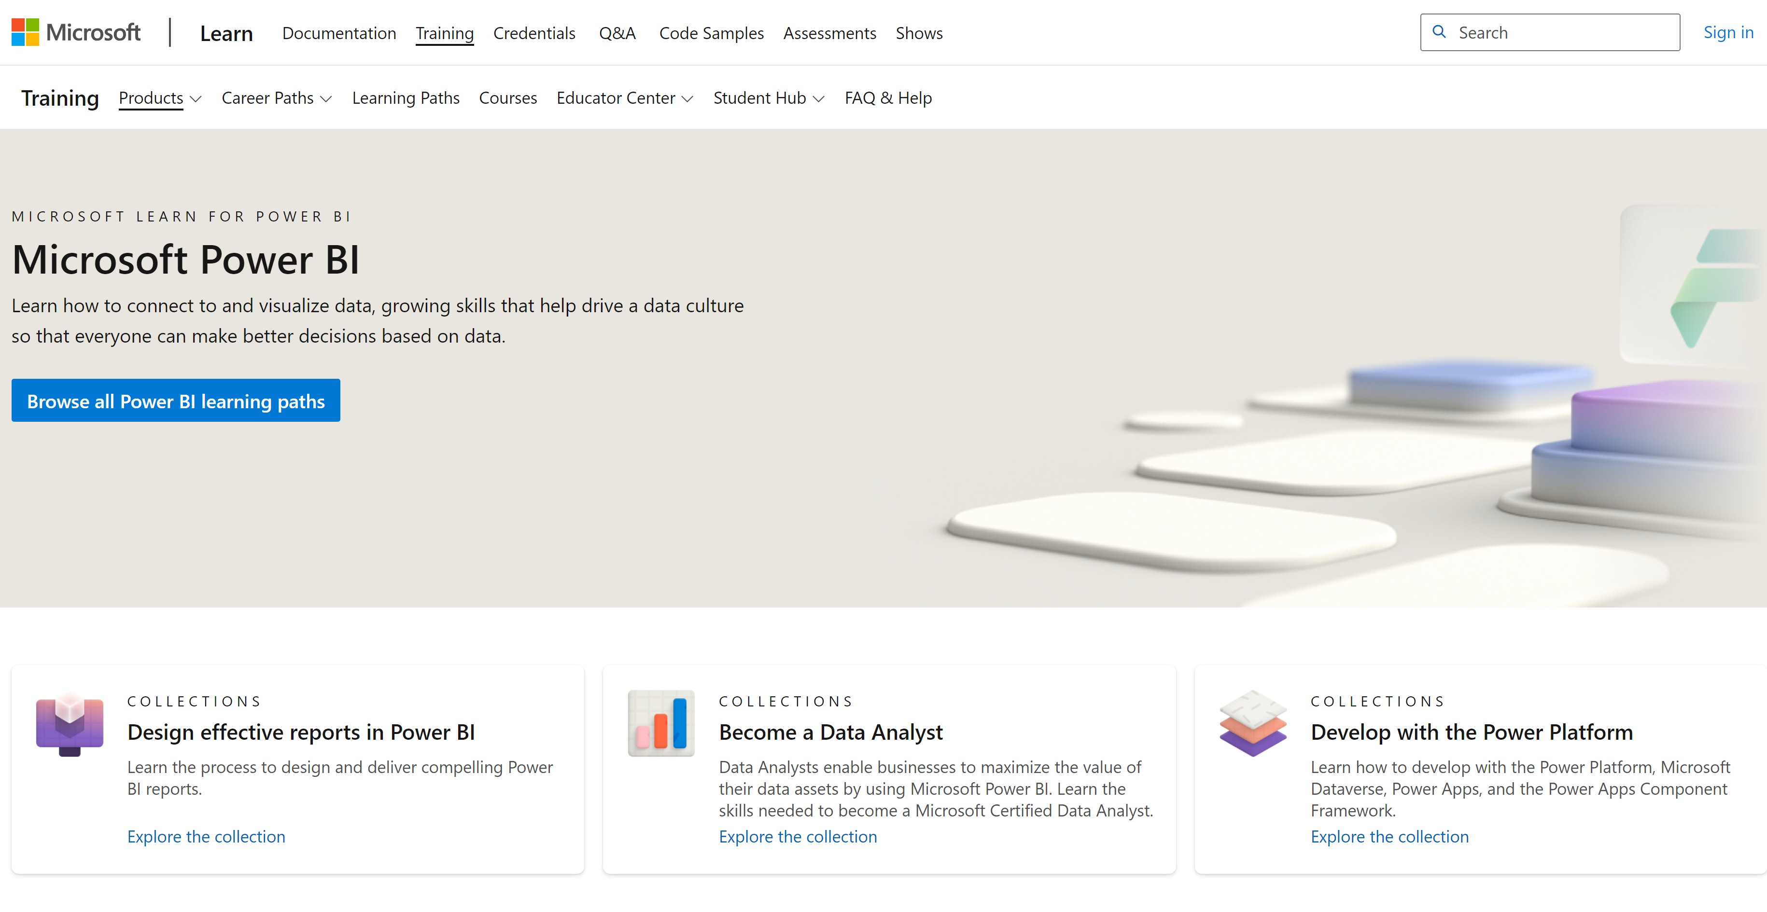
Notes:
PBI training

Slide 19
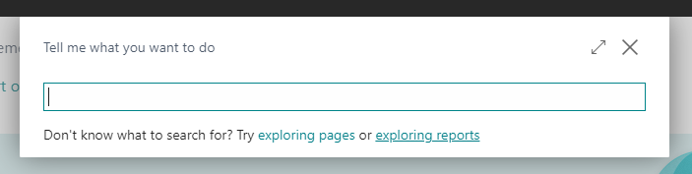
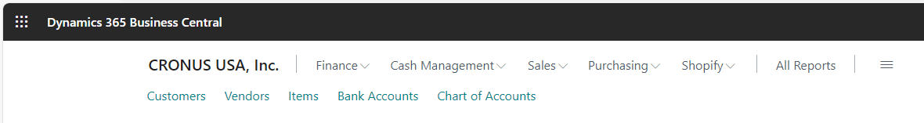
What are these new links???

Slide 20
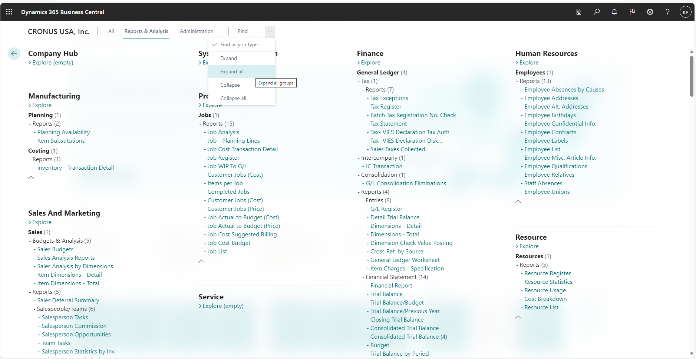
Report Explorer – shows all analytical capabilities
Notes:
If people ask if BC has any reports…

Slide 21
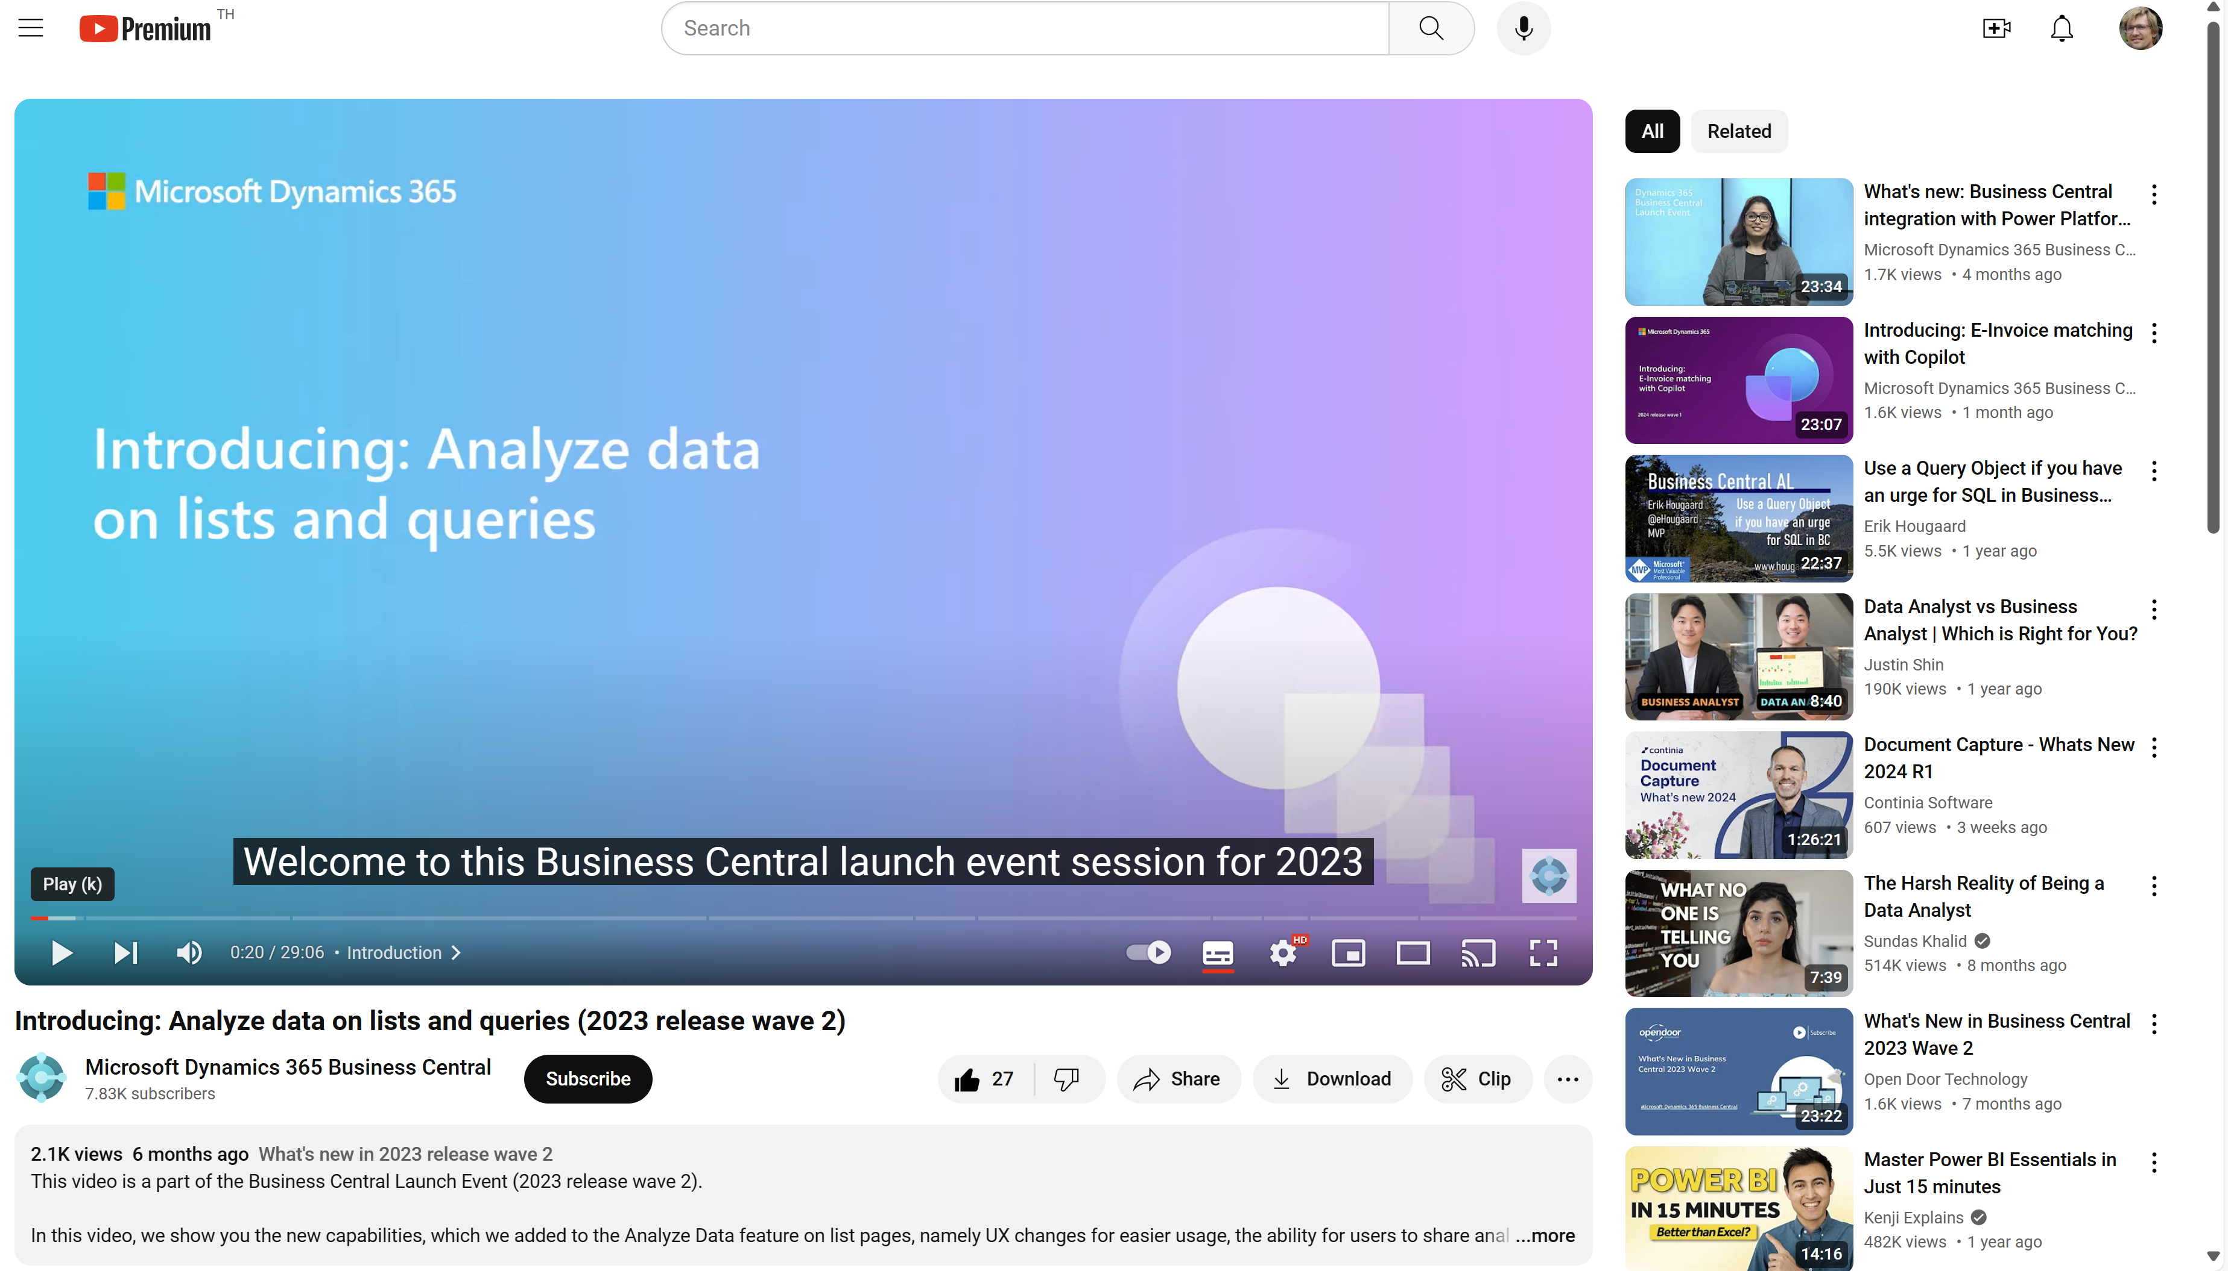
Watch the video to learn more…

Slide 22
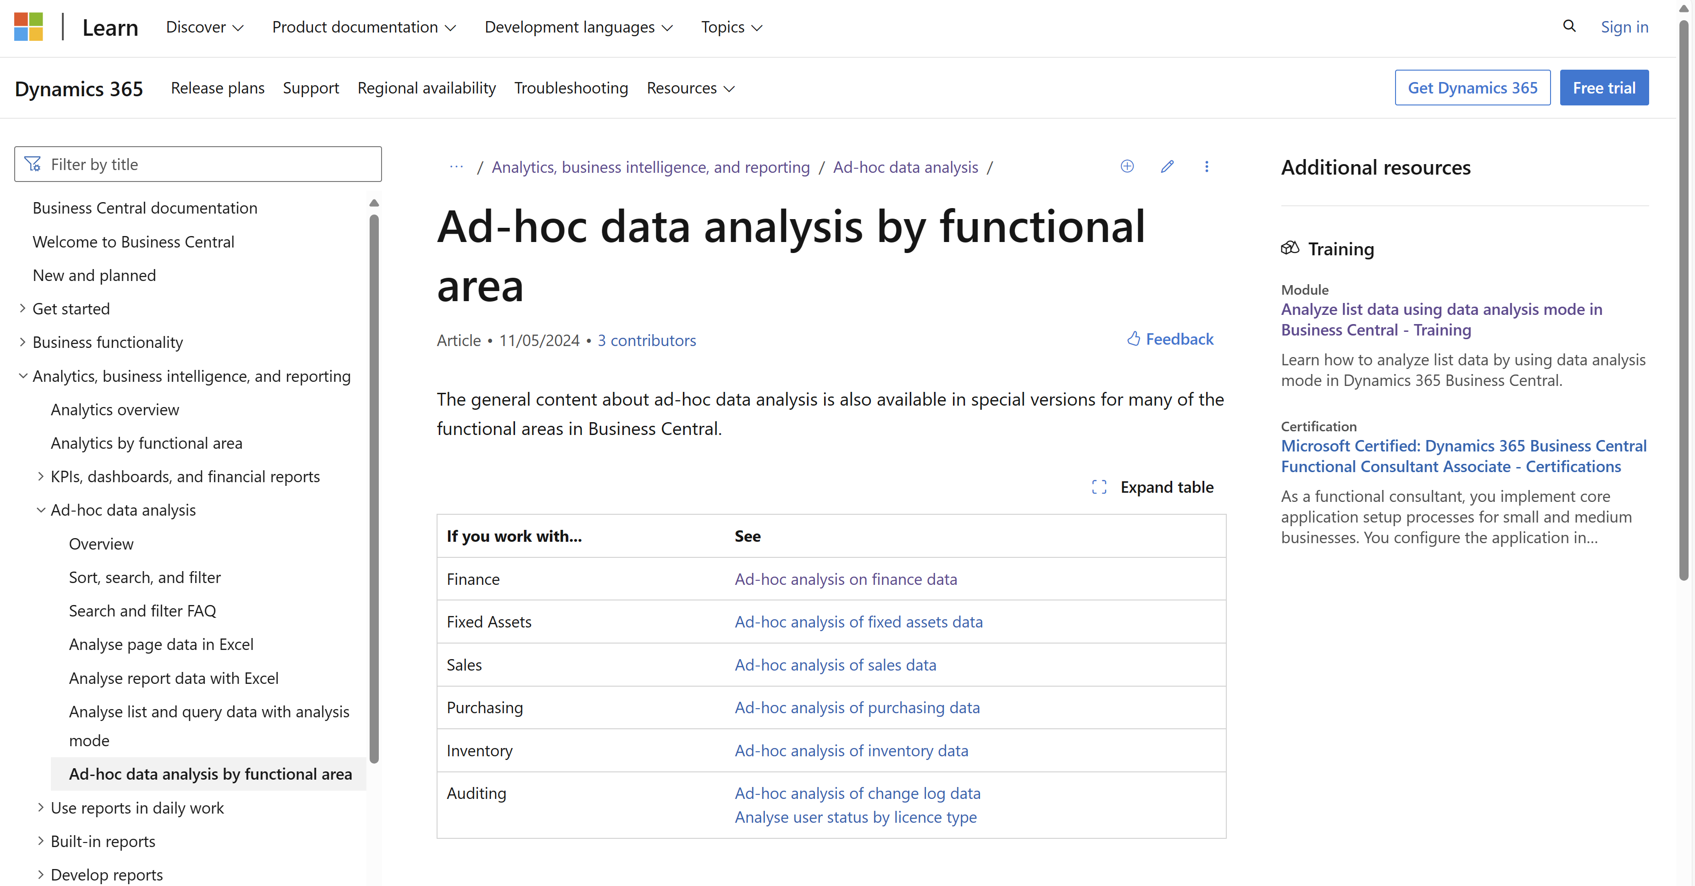
New documentation added (May 2024) aka.ms/bcAnalytics

Slide 23
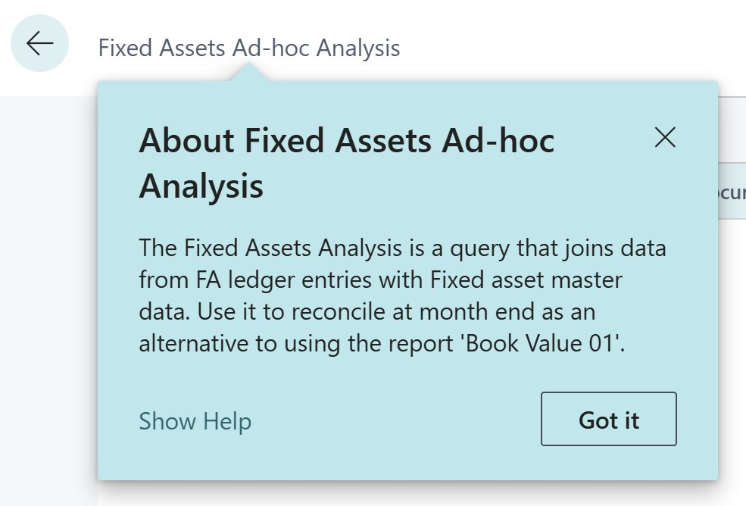
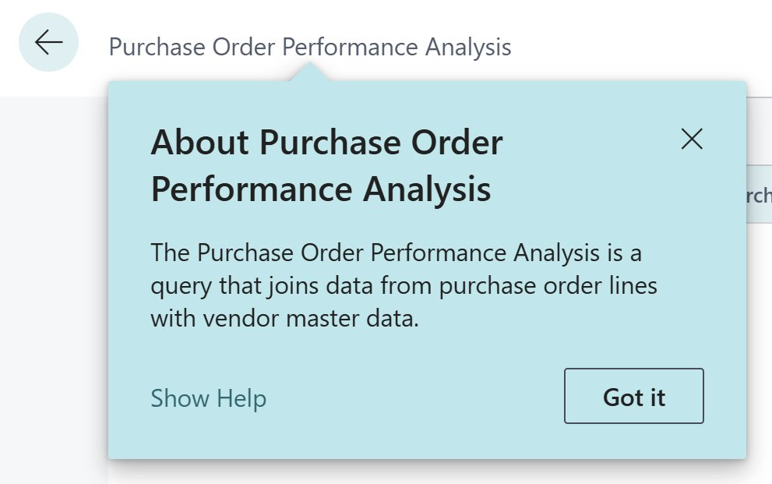
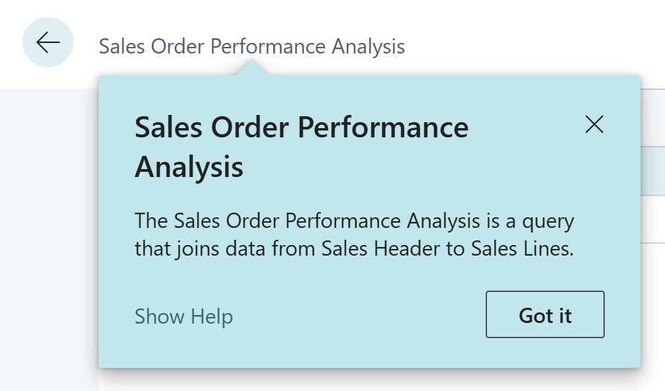
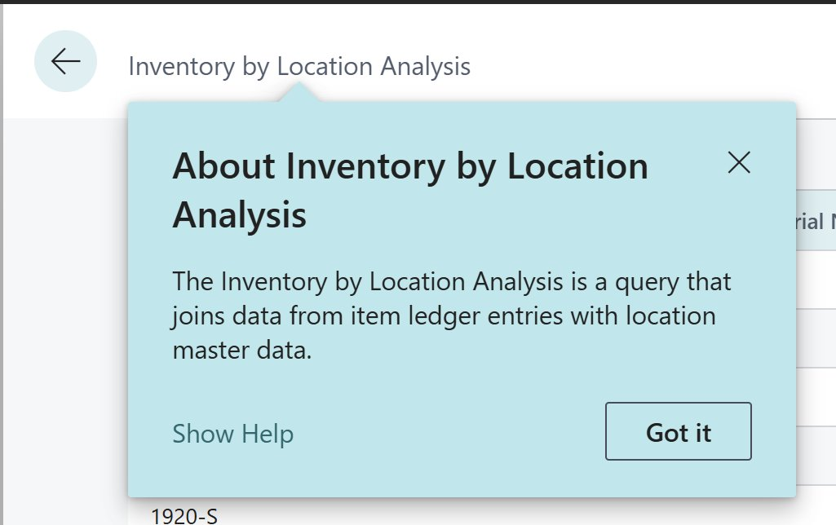
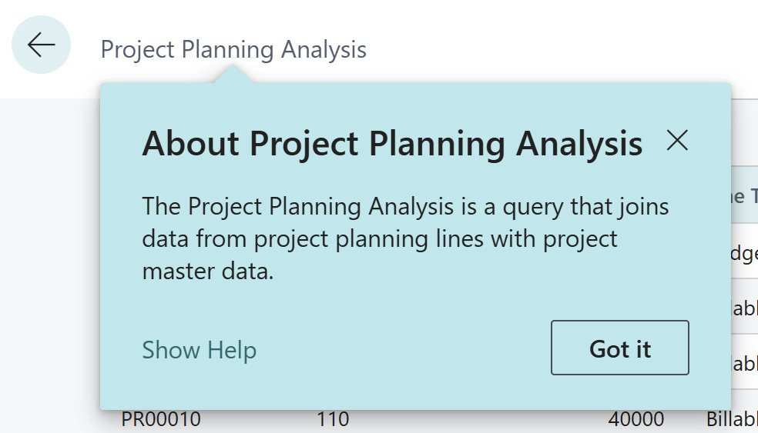
Queries added in 25.3 and 26.1

Slide 24
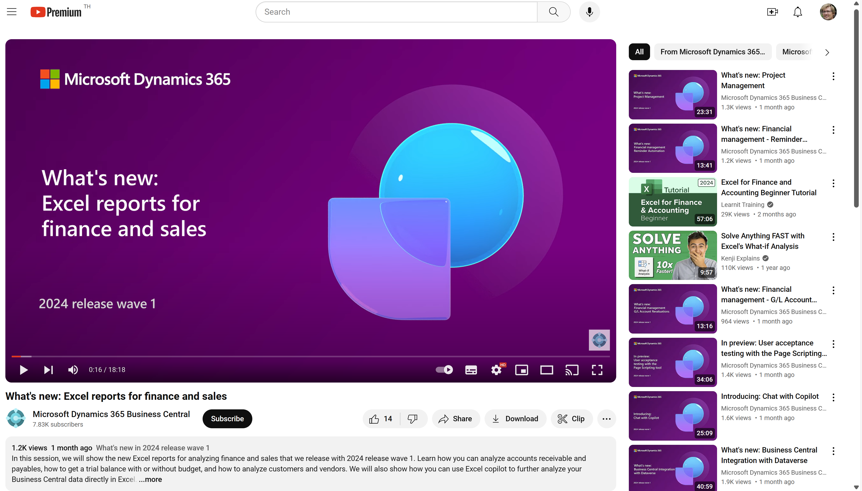
Watch the video to learn more…
Notes:
This video shows the new Excel reports that were shipped in 2024w1

Slide 25
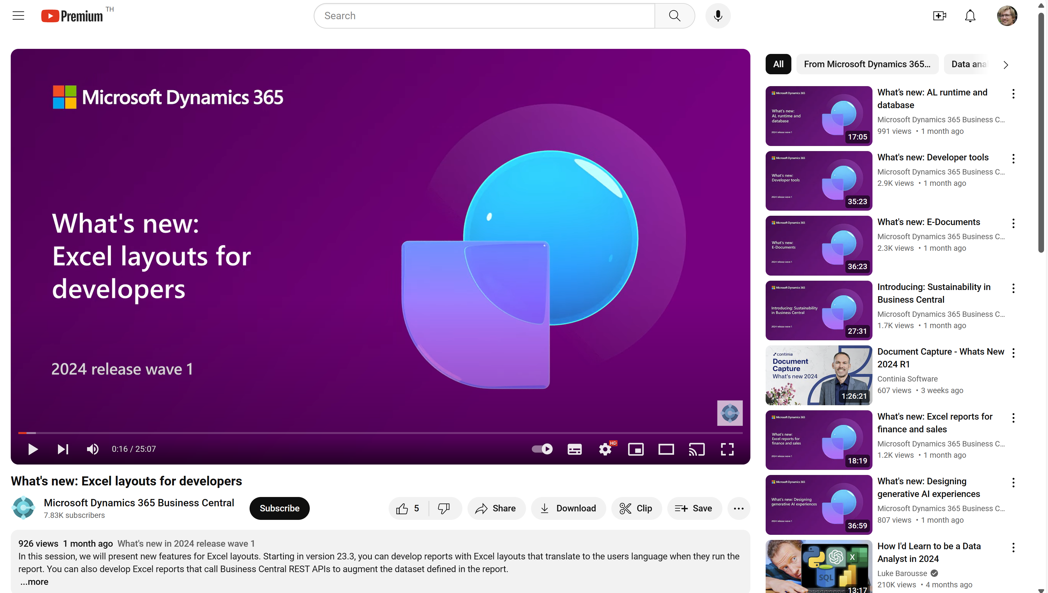
Watch the video to learn more…
Notes:
This video shows the new Excel layout features that were shipped in 2024w1

Slide 26
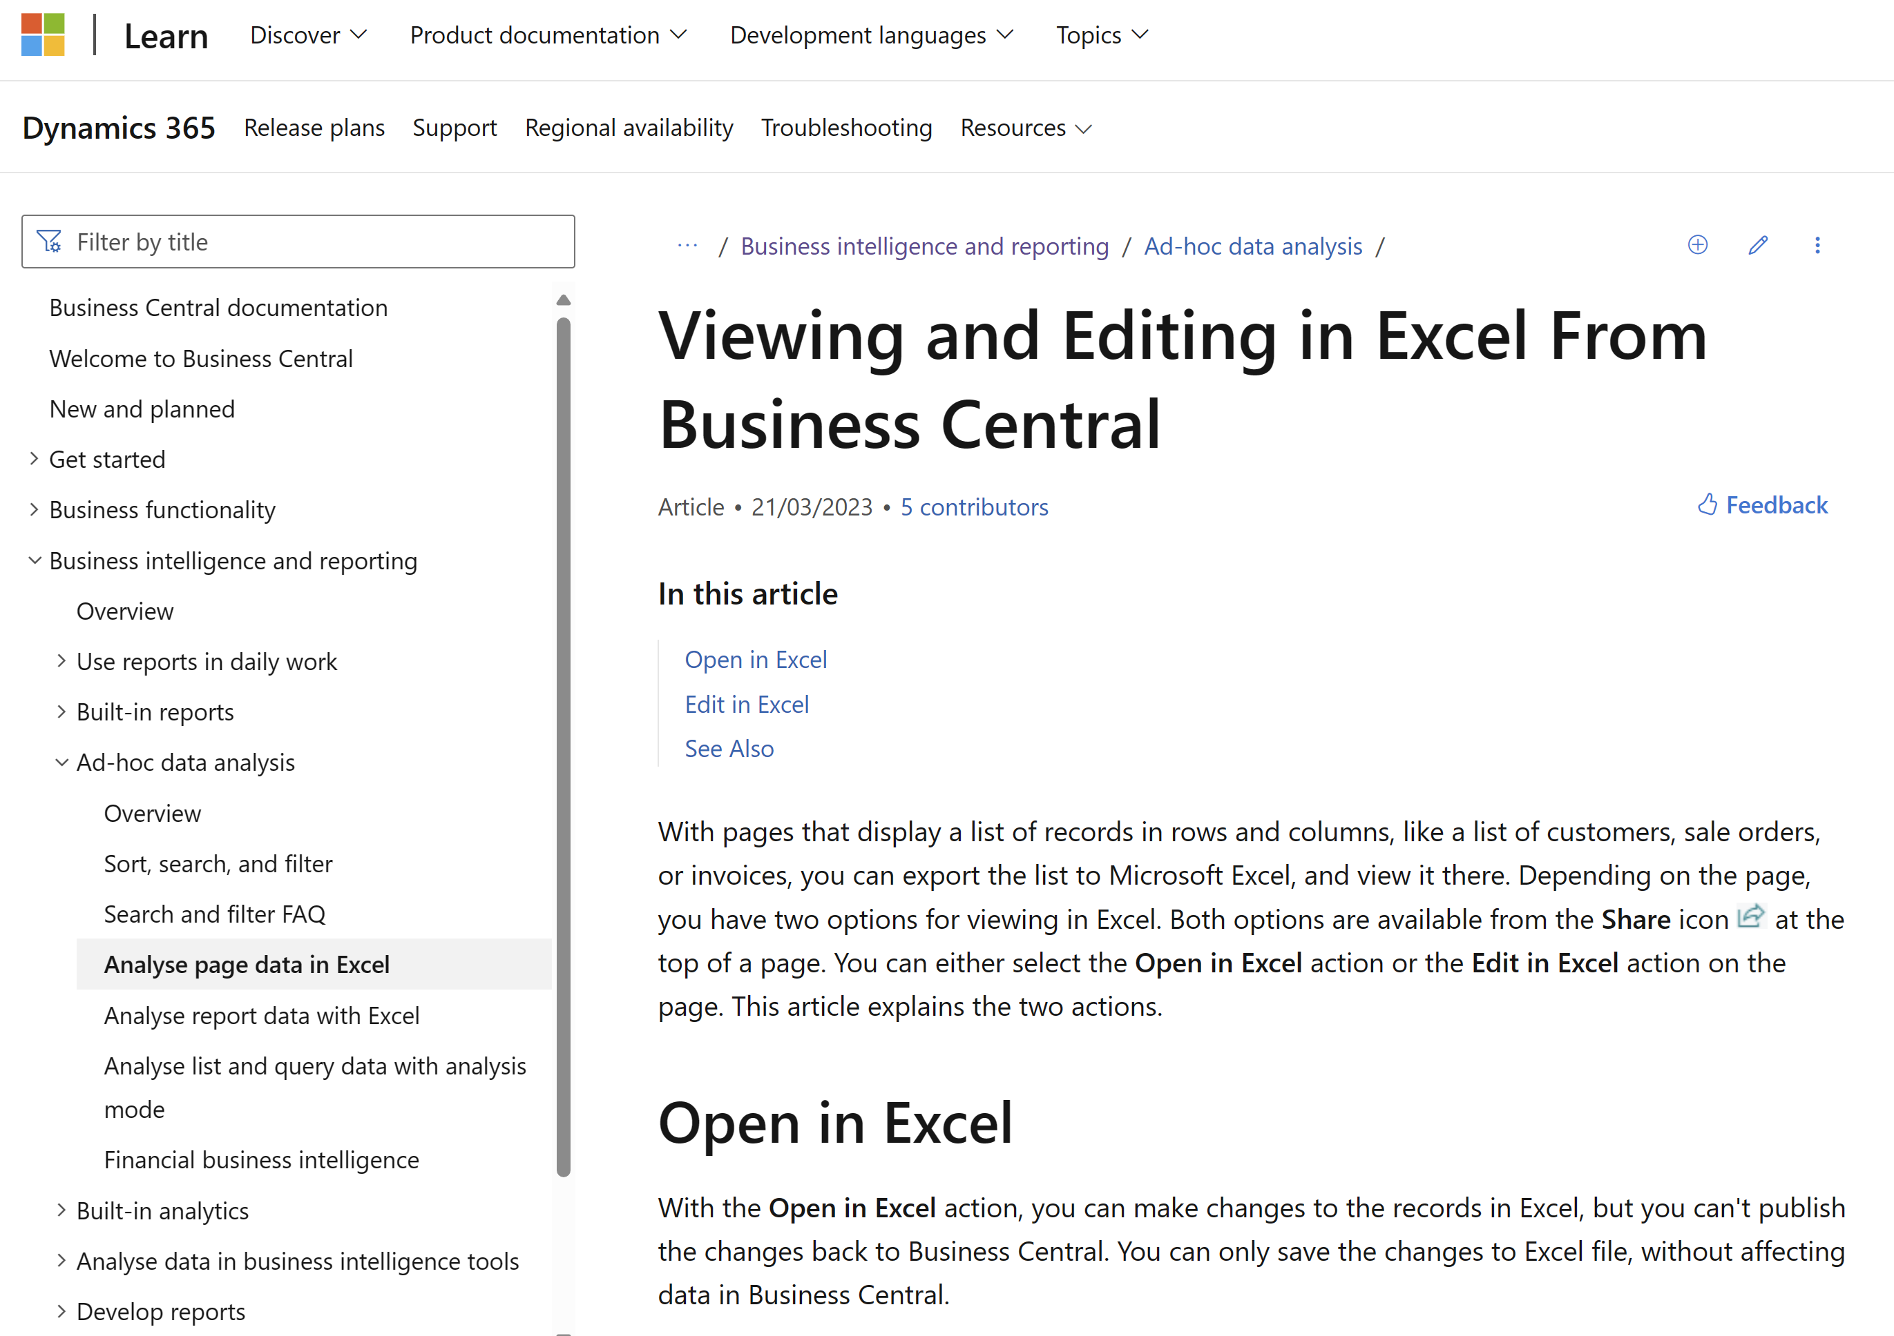
Want to learn more? aka.ms/bcReporting
Notes:
The section in user docs that explains how Excel fits into the analytics story (when consuming data)

Slide 27
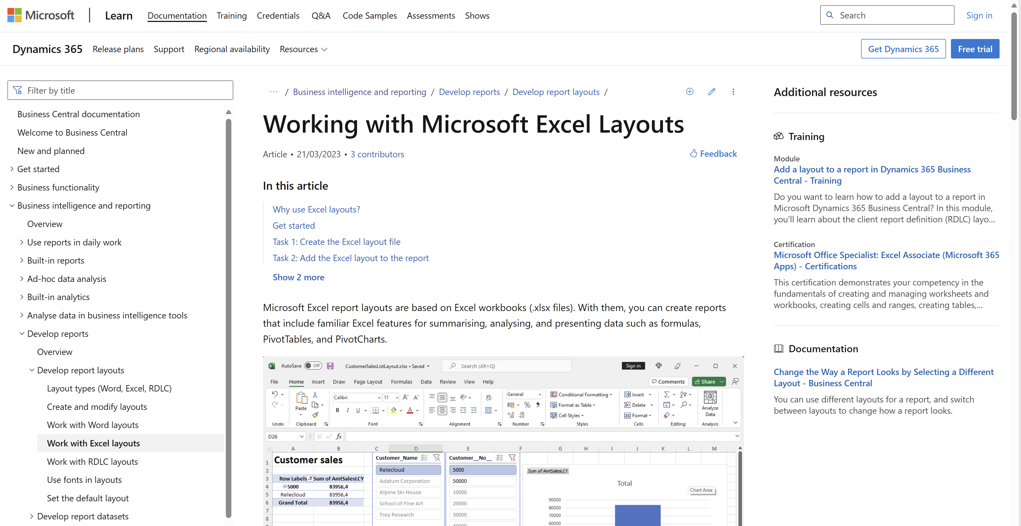
aka.ms/bcReporting
Notes:
The section in user docs that explains how Excel layouts work

Slide 28
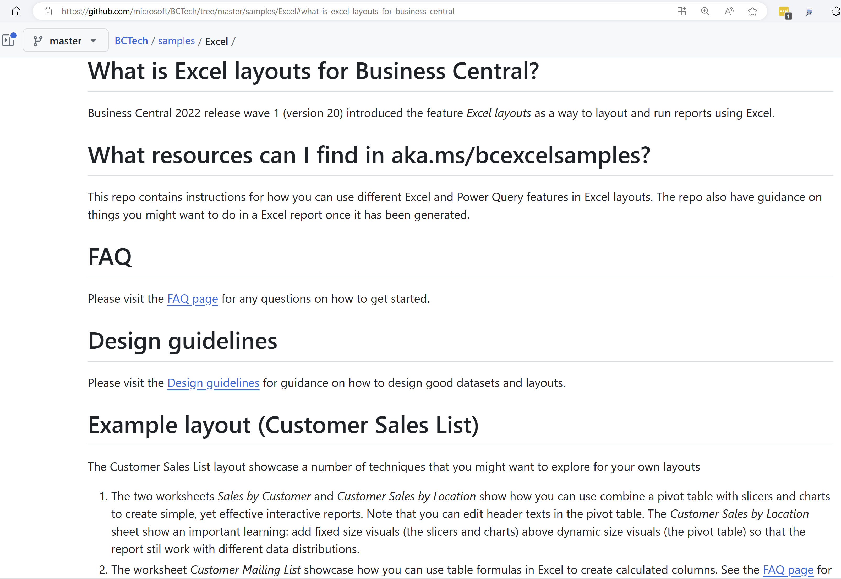
Want to learn through examples? aka.ms/ bcExcelSamples
Notes:
Sample code for learning different techniques. Work with existing reports

Slide 29
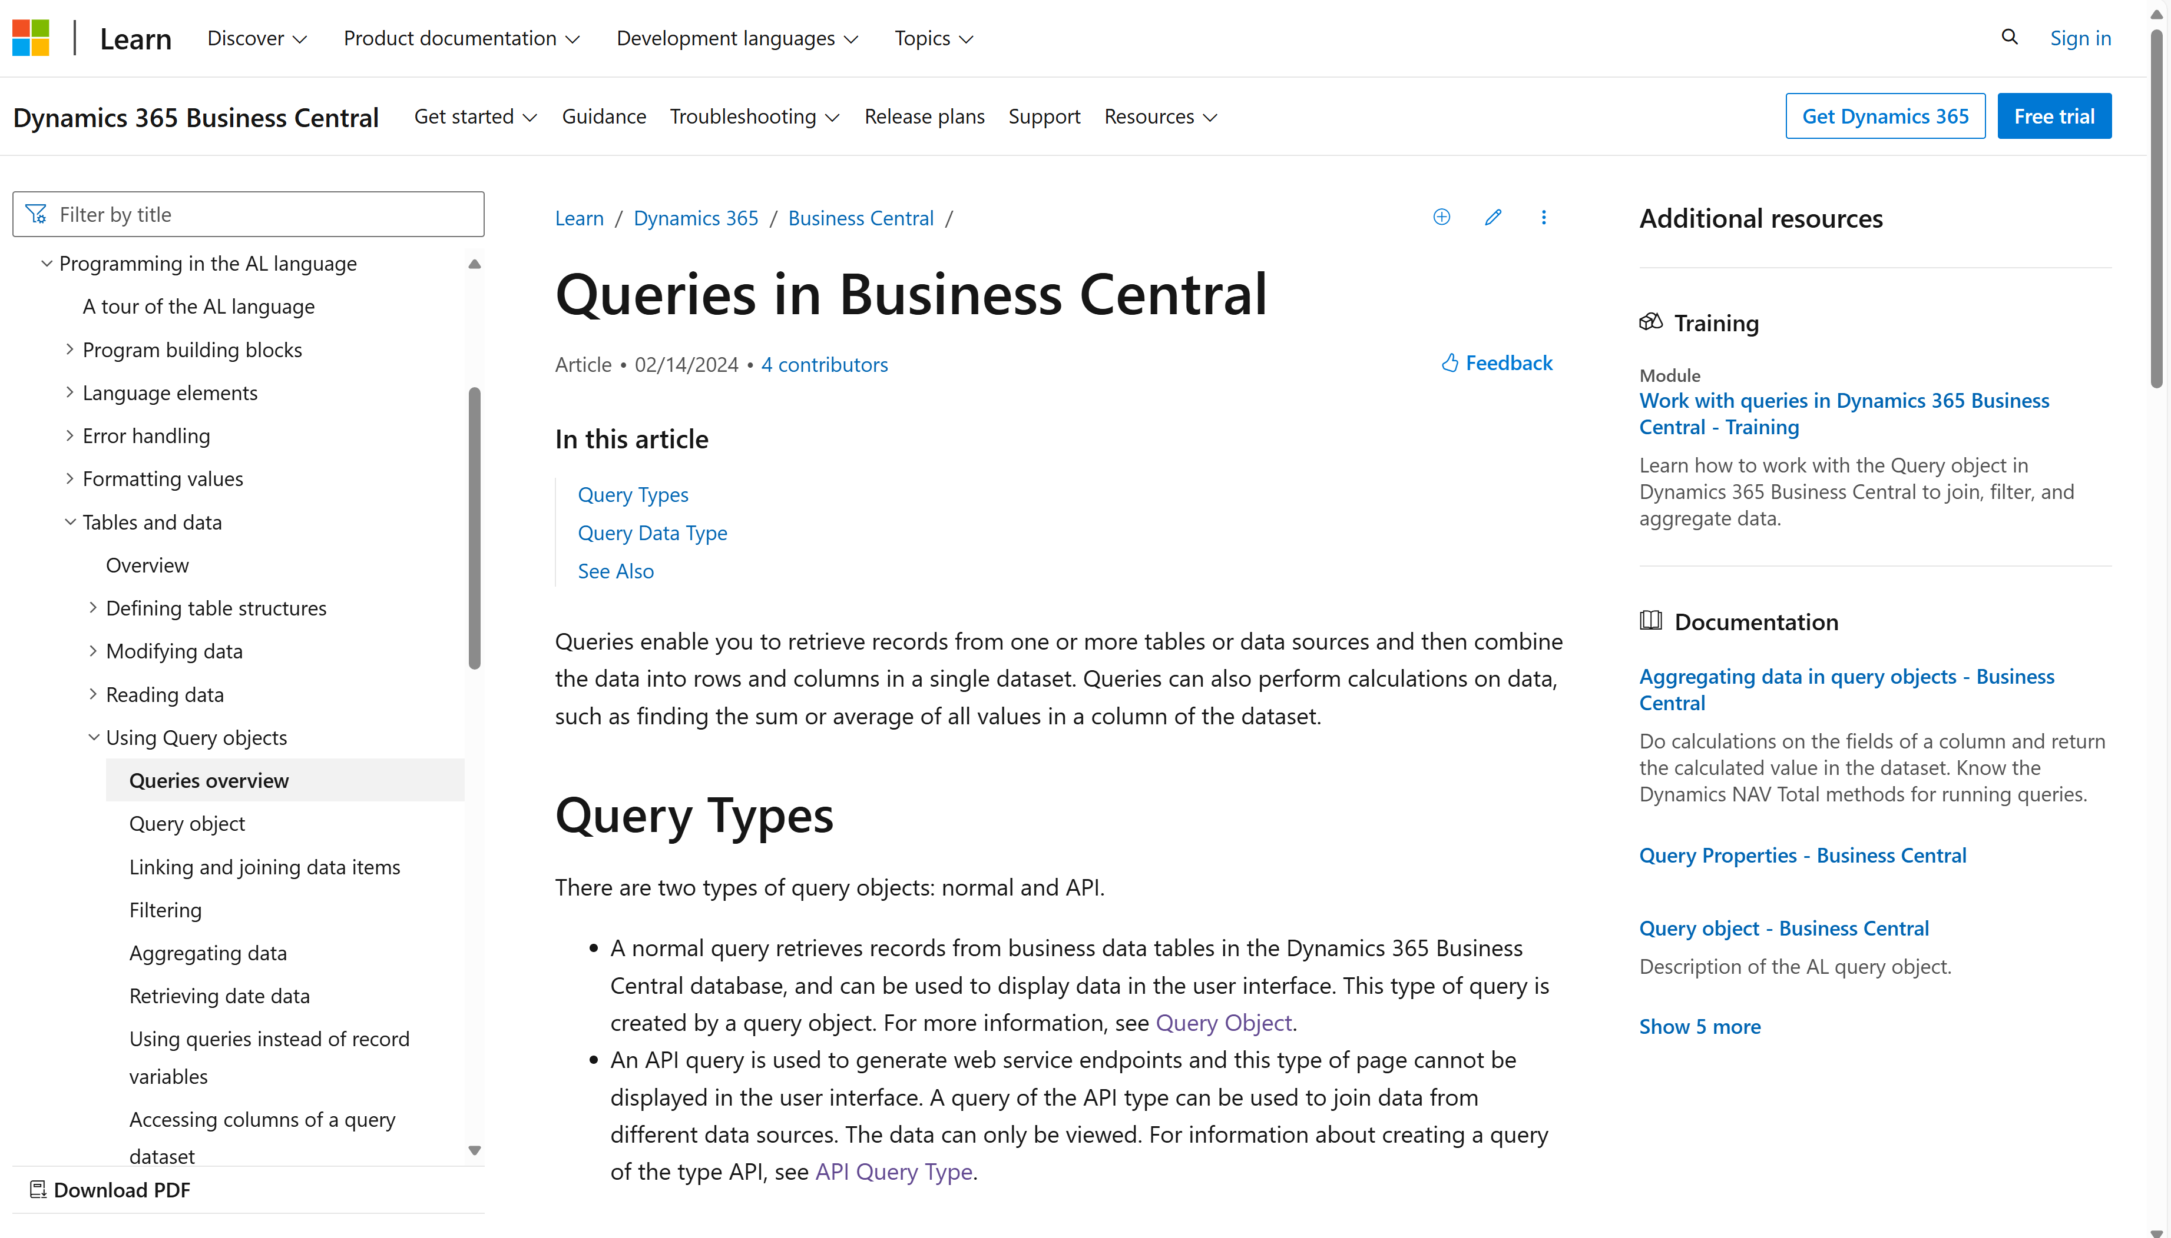
Want to learn more about AL queries?

Slide 30
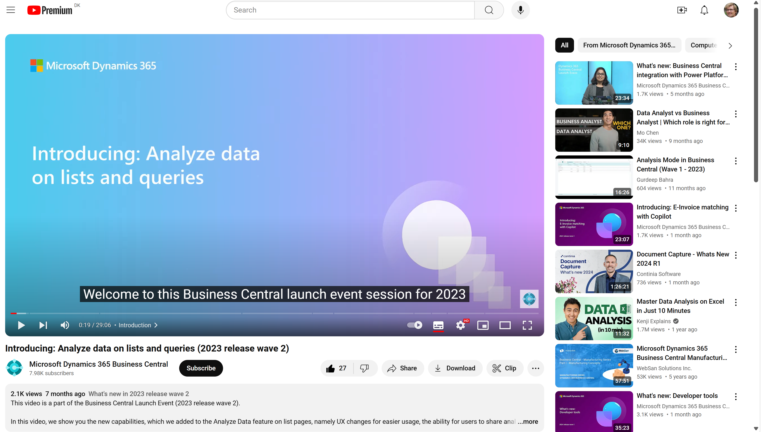
Watch the video to learn more…
Notes:
https://www.youtube.com/watch?v=qmLVKyHRhNc

